Slide 1
PRESAGE-Net
Ching Chang

Slide 2
Outline
Introduction
Related Work
Problem Definition
Solution
Experiments
Conclusion

Slide 3
Introduction

Slide 4
Introduction

Slide 5
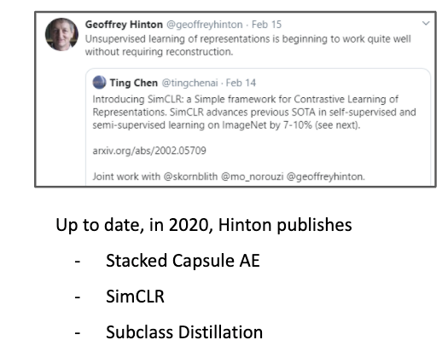
No more AutoEncoder for representation learning after 2020…

Slide 6
Representation Learning for Time Series Data

Slide 7
Related Work

Slide 8
Related Work
Multi-task Learning
Matrix Factorization
Encoder-Decoder
Attention
Self-supervised Learning on Time Series Data

Slide 9
Self-supervised Learning on Time Series Data

Slide 10
Problem Definition

Slide 11

Problem Definition
Input
Multivariate time series $D = [x_{1},x_{2}, …,x_{T}]$, $x_{i}∈R^{n}$ for $i=1…T$, $n$ is number of sensors
Output
Qualities $\hat{q}$, $\hat{q}∈R^{m}$, $m$ is number of qualities
features
qualities
time

Slide 12
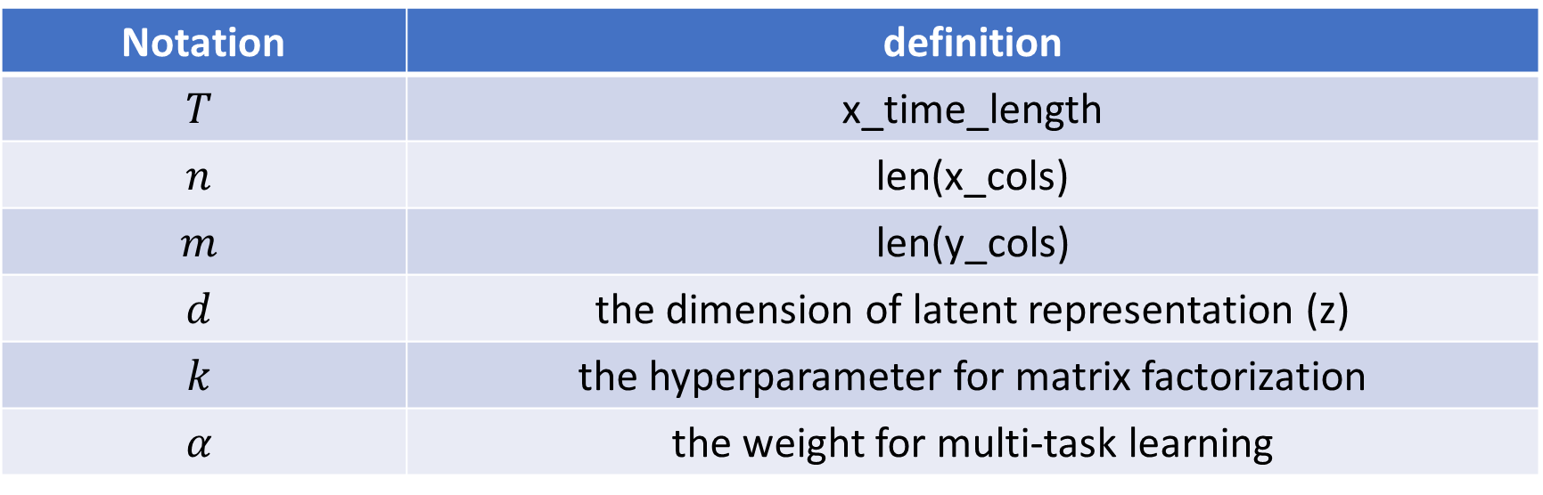
Notations
Notation | definition
$$T$$ | x_time_length
$$n$$ | len(x_cols)
$$m$$ | len(y_cols)
$$d$$ | the dimension of latent representation (z)
$$k$$ | the hyperparameter for matrix factorization
$$α$$ | the weight for multi-task learning

Slide 13
Model Architecture

Slide 14
Outline
DNN
CNN
LSTM
PRESAGE-Net (MLP)
PRESAGE-Net (TCN)

Slide 15








DNN
$$D$$
Reshape
$$D$$
MLP
$$\hat{q}$$
Reshape
$$\hat{q}$$
$$(T, n)$$
$$(T×n,)$$
$$(m,)$$
$$(1,m)$$

Slide 16

CNN
For time dimension: Maintain the same size, and just get what we want at the end
For feature dimension: For the size in the middle, we set them to all equal one and the same number
$$D$$
Conv1d
$$\hat{q}$$
$$(T, n)$$
$$(1,m)$$

Slide 17
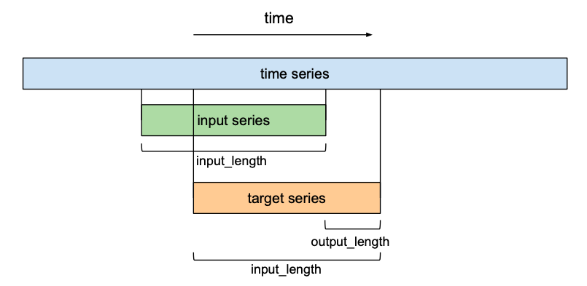


Time dimension
For time dimension: Maintain the same size, and just get what we want at the end
For feature dimension: For the size in the middle, we set them to all equal one and the same number
$$input$$
$$output$$
$$start_index: input_length – output_length$$

Slide 18
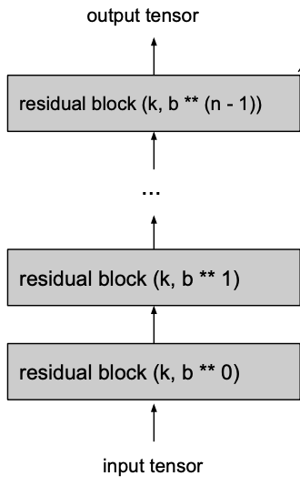




Feature Dimension
For time dimension: Maintain the same size, and just get what we want at the end
For feature dimension: For the size in the middle, we set them to all equal one and the same number
$$output_size$$
$$num_filters$$
$$num_filters$$
$$input_size$$

Slide 19












DNN-Composite
$$D$$
Reshape
$$D$$
Encoder
$$z$$
$D$ Decoder
$$\hat{D}$$
Reshape
$$\hat{D}$$
$$(T, n)$$
$$(T×n,)$$
$$(d,)$$
$$(T×n,)$$
$$(T,n)$$
Reshape
$q$ Decoder
$$\hat{q}$$
$$\hat{q}$$
$$(m,)$$
$$(1,m)$$

Slide 20























PRESAGE-Net (MLP)
$T$ decoder
$$T$$
Reshape
$$T$$
$$(T×k,)$$
$$(T,k)$$
$$×$$
$$\hat{D}$$
$$(T,n)$$
$$D$$
Reshape
$$D$$
Encoder
$$z$$
$F$ Decoder
$$F$$
Reshape
$$F$$
$$(T, n)$$
$$(T×n,)$$
$$(d,)$$
$$(k×n,)$$
$$(k,n)$$
$$×$$
$$C$$
w
$$\hat{q}$$
Reshape
$$(k,m)$$
$$(1,m)$$
$A$ Decoder
$$A$$
$$A$$
$$(n×m,)$$
$$(n,m)$$

Slide 22


















PRESAGE-Net (Original)
$A$ decoder
$$A$$
$$m×n$$
$$×$$
$$C$$
w
$$\hat{q}$$
$$m×k$$
$$m×1$$
$$D$$
Encoder
$$z$$
V decoder
$$V$$
$$n×T$$
$$d×1$$
$$n×k$$
$$×$$
$$\hat{D}$$
$$n×T$$
H decoder
$$H$$
$$k×T$$

Slide 23








PRESAGE-Net
$A$ decoder
$$A$$
$$n×m$$
$$×$$
$$C$$
w
$$\hat{q}$$
$$k×m$$
$$1×m$$
$$D$$
Encoder
$$z$$
V decoder
$$V$$
$$T×n$$
$$1×d$$
$$T×k$$
$$×$$
$$\hat{D}$$
$$T×n$$
H decoder
$$H$$
$$k×n$$

Slide 24










PRESAGE-Net
$A$ decoder
$$A$$
$$(n,m)$$
$$×$$
$$C$$
w
$$\hat{q}$$
$$(k,m)$$
$$(1,m)$$
$$D$$
Encoder
$$z$$
H decoder
$$H$$
$$(T, n)$$
$$(1,d)$$
$$(k,n)$$
$$×$$
$$\hat{D}$$
$$(T,n)$$
V decoder
$$V$$
$$(T,k)$$

Slide 25
Experiments

Slide 26
Experiments
Quality Prediction
Time Series Reconstruction
Model Interpretability
Context Vector and Latent Vector
Model Transferability
Time Series Attention
Parameter Study

Slide 27
Loss
Quality Prediction
MSE, MAE, SMAPE
Time Series Reconstruction
MSE, MAE, SMAPE
Use the same loss for quality prediction and time series reconstruction

Slide 28
Training settings throughout epochs
Epoch
Learning rate decay
0
First 50 epochs
Train reconstruction network
Find good initial point
Gamma decay
5e-05
50
1
70
5e-06
50 ~ 250 epochs
Joint training
0
150
170
5e-07
250

Slide 29
Quality Prediction
 | MCMP |  |  | dataset2 |  |  | dataset3
Loss for quality prediction | MSE | MAPE | SMAPE | MSE | MAPE | SMAPE | MSE | MAPE | SMAPE
DNN | 3.14
DNN-Composite | 5.14
CNN
CNN-Composite
LSTM
LSTM-Composite
NBEATS
TCN
NHiTS
PRESAGE-Net (MLP)
PRESAGE-Net (TCN)

Slide 30
Quality Prediction (MSE/MAE/SMAPE)
 | MCMP |  |  | dataset2 |  |  | dataset3
Representation Learning | NA | Auto Encoder | Contrastive Learning | NA | Auto Encoder | Contrastive Learning | NA | Auto Encoder | Contrastive Learning
DNN | 3.14 14.42 24.56
CNN | 3.14 14.42 24.56
LSTM | 3.14 14.42 24.56
PRESAGE-Net (MLP) | 3.14 14.42 24.56
PRESAGE-Net (TCN) | 3.14 14.42 24.56

Slide 31
Quality Prediction (MSE/MAE/SMAPE)
 | MCMP |  |  | dataset2 |  |  | dataset3
Representation Learning | N/A | AE | CL | N/A | AE | CL | N/A | AE | CL
DNN | 3.14 14.42 24.56
CNN | 3.14 14.42 24.56
LSTM | 3.14 14.42 24.56
Representation Learning | MF-AE | AE | MF-CL | MF-AE | AE | MF-CL | MF-AE | AE | MF-CL
PRESAGE-Net (MLP) | 3.14 14.42 24.56
PRESAGE-Net (TCN) | 3.14 14.42 24.56

Slide 32
Conclusion

Slide 33
Thanks for your attention

